Slide 1
Power monitor project
Group 23 progress report

Slide 2
Introduction
To design and develop a wireless energy monitor to measure and display the amount of energy consumed by a household appliance in a smart house.
Wireless Energy motor composed of two systems
signal measurement unit and a base station
A system

Slide 3
Project Specifications
AC Voltage Supply - 12 ~ 14 Vrms
Maximum Load - 7.5VA
Power rating - 100mW ~ 200mW
Frequency - 800Hz ± 10%

Slide 4
Existing Products
Existing products – 1-2 slides presenting 3 commercially available energy monitor products. Photos, manufacturer details, pricing and features can be included in these slides

Slide 5
Comparison with commercial products
Products | TED MTU Home |  |  | Project
Phase | Single | Single

Slide 6
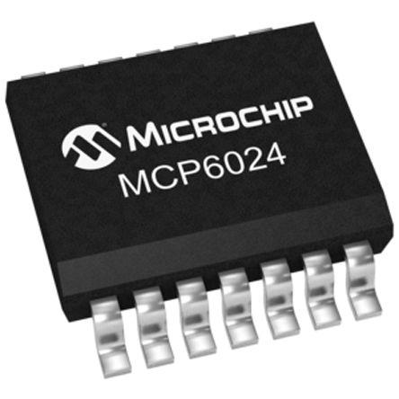
Op Amp
MCP 6024
Slew Rate of 7V/µs
Rail to rail input and output
Power supply range of 2.5V to 5.5V

Slide 7
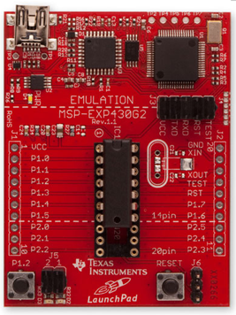
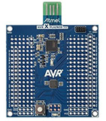
LaunchPad vs ATmega328p
MSP430 LaunchPad:
LaunchPad is a low-cost, low-power consumption microcontroller from Texas Instruments.
With a value of $4.30 US, the LaunchPad could act as a good alternative to the ATmega328p that has a price of $10 US.
8-channel 10-bit ADC,
Two MSP340 flash-based MCUs
16KB flash memory
512 Bytes of Ram
Universal serial interface
10-pin Female connectors
ATmega328p Xplained mini kit:
32KBytes of in system
self-programmable Flash
1Kbytes EEPROM
2KBytes internal SRAM
32 x 8 general purpose working registers
8-channel 10-bit ADC
Programmable serial USART
1.8 - 5.5V operating voltage
23 general purpose I/O lines

Slide 8
Analogue Schematic
A schematic diagram of your proposed measurement unit – This will be based on the LTSpice simulations you have completed. The schematic has to be clear and proper component values should be shown (resistors and capacitors from appropriate series). You should try to use a proper engineering drawing package (ex. Visio) rather than including a print screen of your LTSpice schematic.

Slide 9
C program
Flow chart of the embedded C program – This should tell us how you are going to implement the embedded C program for your energy monitor.

Slide 10
VHDL receiver design
Finite state machine and data-path components for the base station - This should tell us about your VHDL design.

Slide 11
VHDL frame receiver Finite State Machine
Wait till end of start bit
Loop for 8 bits
Wait for end of stop bit
Data input is High
Store data frame
Idle
Start
Data
Stop
Data input is low
Restart bit counter
Wait till end of bit, store data
Wait till end of frame, return to Idle state. Shift whole frame to output

Slide 12
VHDL frame receiver Finite State Machine
!Data_low/
!Start_Cap/ pcount_en
Pulse_Cap, !Frame_Cap/
Pcount_reset, shift, ncount_reset
!Pulse_cap/ pcount_en
Start_Cap/ pcount_reset, ncount_reset
Data_low/
pcount_reset
Idle
Start
Data
Stop
Pulse_cap, Frame_Cap/ pcount_reset, shift
!Pulse_Cap/ pcount_en
/Shift_out

Slide 13
Full VHDL design

Slide 14
Extra Info
Any other important information – Up to 2 slides. If you have any interesting design ideas, or design challenges that you have to overcome you can mention it here. Also if you plan to complete the smart energy challenge tell us how you plan to do it.

Slide 15
Project plan
Project plan, division of work, conclusions and references – up to 3 slides

Slide 16
http://www.theenergydetective.com/downloads/TED%20Pro-Lite-Home%20Spec%20rev%208.0.pdf

